Slide 1



Release 1 : Team 33
COMPUTER VISION APPLICATION FOR REAL-TIME MULTI-MODAL PRODUCT DETECTION
Chetan Mahipal, Rohan Shridhar, Badarla Rohan Naidu, Aanvik Bhatnagar, Rohan Rathee

Slide 2

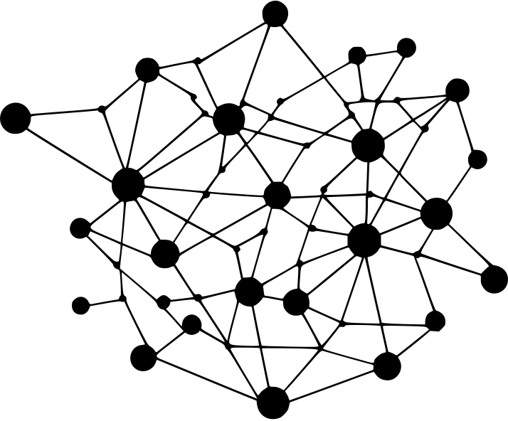
INTRODUCTION TO PRODUCT DETECTION
In today's fast-paced world, efficient product detection holds immense significance across diverse industries.
Leveraging computer vision (CV) algorithms, particularly those empowered by deep neural networks, offers a promising solution to this challenge.
This multimodal product detection algorithm, developed by our client accurately identifies products from both static images and live video feeds.

Slide 3
The primary objective is to make these powerful CV capabilities widely accessible through a user-friendly mobile platform.
The application will support two key functionalities: still image recognition and real-time video analysis.
Users will be able to capture a photograph or stream video directly through the app, which will then communicate with cloud-based computing resources to process the data using existing CV algorithms.
The processed information will be swiftly relayed back to the mobile application, ensuring users receive low latency, real-time results.
Mission
STATEMENT

Slide 4



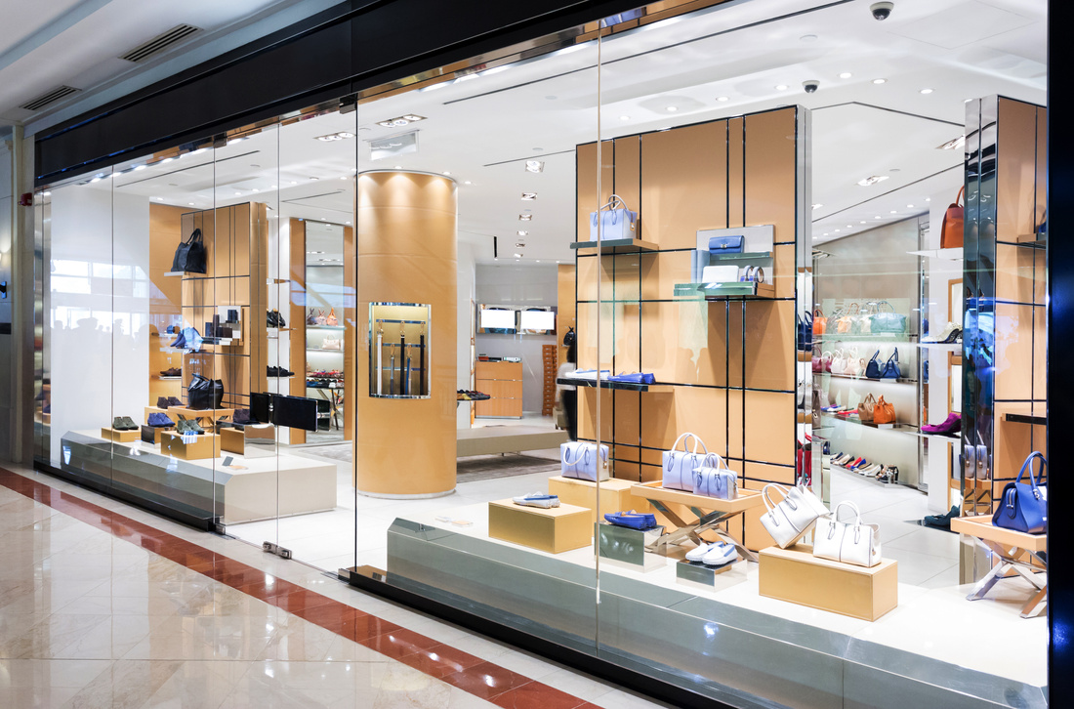


Target Market
Who are the customers you want to cater to?
Clients of Perceptive Analytics
Retail Stores
Admin of stores, with a little
knowledge of software but are handy in using applications on mobile devices.
An ordinary person who is interested in basic functionalities, and not much technical background.
Inventory
Management
Delivery System Companies
Helps in keeping the stock updates and need for
restocking when required.
Officials who keep a check
at the quantity delivered by delivery guy, who is handy with mobile apps.

Slide 5
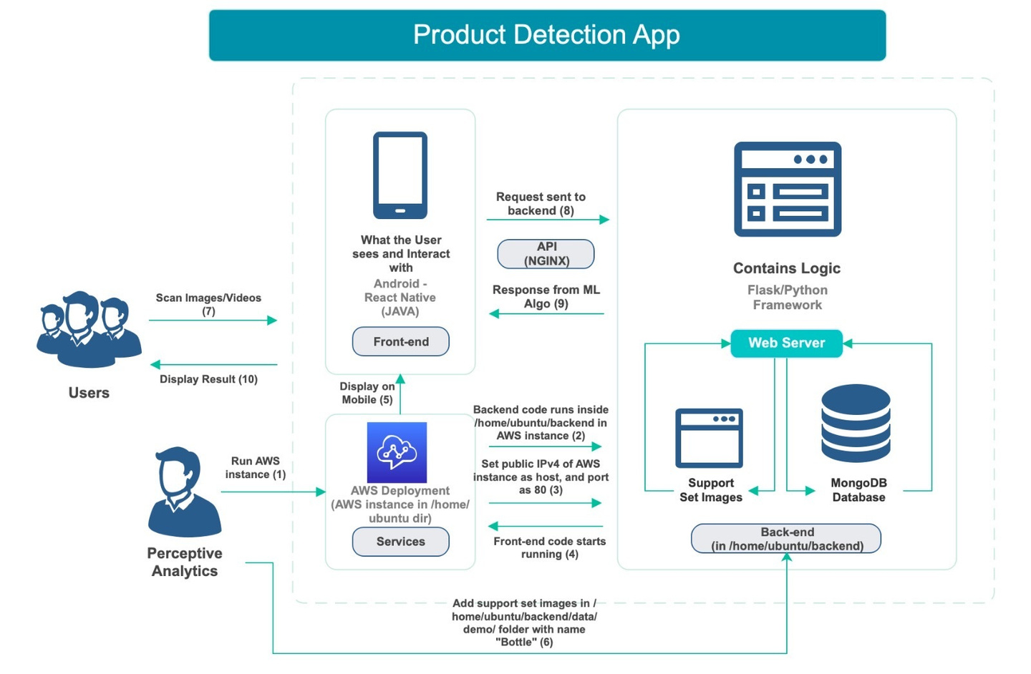
Current App Architecture
How the currrent implementation of app deployed on AWS looks like

Slide 6


Current App Issues
1
2
3
Lacks user friendly interface
Technical complexities
Cloud Service Connectivity
The current implementation of the app is not visually appealing, and is not self-explanatory. We need a responsive and seamless experience.
The codebase includes some errors, like deprecated frameworks, image incompatibility and other generic bugs.
For the scalability of the app to a larger level, we need to look into all the deployment options and provide them a mechanism.

Slide 7

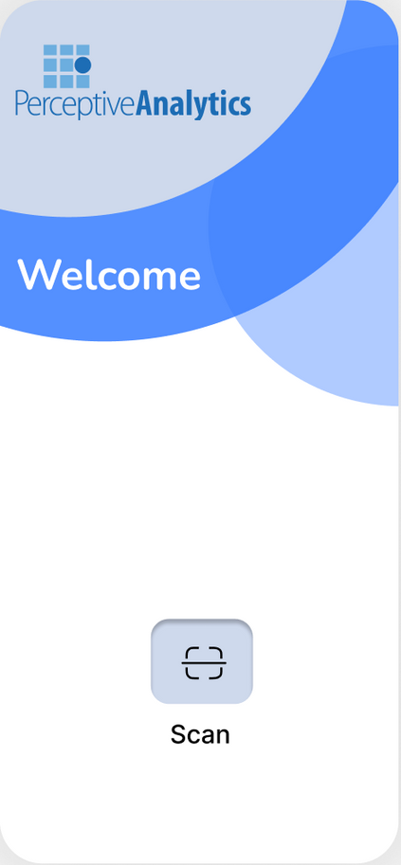

Deliverables
Responsive UI
1
We aimed to improve the user interface by better design layout, and easily understandable procedural steps.
Robust App Architecture
2
Based on the current framework(s) of the app that the codebase is using, deprecations are removed, and updated compatible versions.
Cloud Deployment Options
3
Leveraging cloud computing, our solution aims to provide swift and accurate results directly to users' mobile devices.

Slide 8



PHASE PLAN
Phase 1
Phase 2
Phase 3
Frontend:
Home Page UI
Camera Page UI
Backend:
Image Processing
Frontend:
Items Page UI
Detected Frames UI
Backend:
Image Viewer
Items Page Backend
Release 1
Backend:
Video Viewer
AWS Deployment
Video Analysis
Documentation
Improvements before Final Release

Slide 9

Technology
React Native + NodeJS (Frontend)
Support for third party tools
Fast and Responsive across cross platforms
Extensive Documentation and Tutorials
Good for lightweight application
REQUIREMENTS
Python3 + Flask (Backend)
Based on the current implementation framework and codebase of the app, and upon reading the available documentation, we have divided the requirements into three broad categories. For the detailed system requirements please refer to SRS.
More control over app design
Easily scalable for smaller applications
Python Libraries for AI-ML Support
Flexibility on Structuring
ExpoGo (Phone Rendering)
Runs seamlessly on both iOS and Android platforms without the need for separate codebases.
Supports hot reloading, allowing developers to see changes in real-time as they modify code.
Provides access to native device features and APIs through its extensive library of pre-built modules.

Slide 10

Product
FEATURES
01
Home Page
02
Camera Page
This is the first page that will open when the app is run. There is a scan button which redirects the user to camera page where they can scan any object.
Here the user has three options: clicking a picture, taking a video, or uploading image/video from gallery.
03
Items Page
04
Detected Image Frames
After the image/video is sent to scan from Camera Page, then the detected items are displayed in a table, where quantity can be modified, and image can be viewed.
On the items page, if the user wants to see the frames that have been detected from CV Algorithm, then by clicking on image, they can see all the frames.

Slide 11
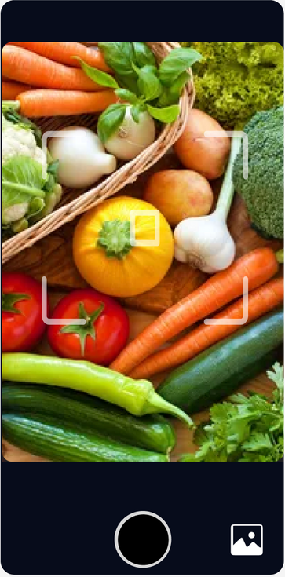
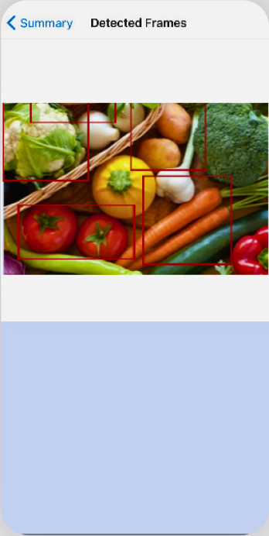
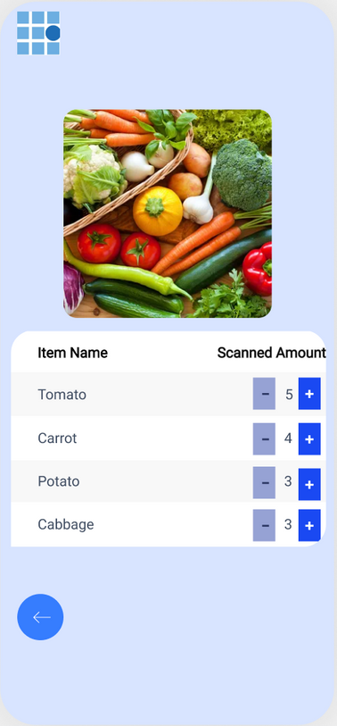
Home Pag﻿e
Items Pag﻿e
Camera Page
Image
Frames

Slide 12
Deprecated Frameworks
base64 Image Processing
The Expo Go updated it’s version
with compatibility issues with
react native and it’s libraries.
Fix: Created a Bash Script that
would make the package.json
with compatible versions
Detected image in base64 format was not getting displayed on Items Page
Challenges Faced Before Release 1
Fix: base64 image needed to be decoded in the codebase
Node JS version
Digital Ocean Deployment
The latest version of Node is 21.7.1 but for the functioning of app, version 16 is required
Client asked us to check whether Digital Ocean VM can be used for deployment, however MongoDB was not getting installed there. Asked for AWS in R2.
Fix: Used ‘npm’ for version control from 21 to 16 as default

Slide 13

Future Roadmap
Our plan after Release 1 (also mentioned in Project Plan v2)
Release 1 Documentation
Video Processing
AWS Deployment
Real Time Testing (Video+AWS)
19TH MARCH 2024
2ND APRIL 2024
4TH APRIL 2024
10TH APRIL 2024

Slide 14

The Team
Aanvik Bh
Rohan S
Rohan N
BACKEND TEAM
FRONTEND TEAM
FRONTEND TEAM
Image Processing
SRS Document
Status Tracker
Cloud Deployment
Cost Analysis
R1 Presentation
Home Page
SRS Document
Figma Actions and UI
Home Page
Camera Page
Design Document
Item’s List
SRS Document
Chetan M
Rohan Sh
BACKEND TEAM
FRONTEND TEAM
Deprecation Removal
Project Plan and Synopsis
Image Viewer & Processing
Items Page Backend
Test Plan Tracker
App Architecture
Item’s Page and Viewer
Design Document
Figma Actions and UI
Upload Functionality
Camera Page

Slide 15
Thank You

